Slide 1
Emergency Response Analytics
and Decision Optimization
Data Analytics (10204210) — BTEC Unit F/618/7415
Student Name / ID / Section
Academic Year 2025–2026
1/22

Slide 2
What is data analytics?
Data analytics is the process of examining data to uncover patterns, trends, and insights that inform decision-making. It transforms raw operational data into actionable intelligence.
Descriptive
Predictive
Prescriptive
"What happened?"
"What will happen?"
"What should we do?"
Summarises historical data using statistics and visualisations to understand past performance.
Uses machine learning models to forecast future outcomes from historical patterns.
Optimises decisions using algorithms that find the best action within constraints.
Activity 1: 9 techniques on 105K incidents
Activity 2: 4 models including LSTM
Activity 3: Genetic Algorithm with pygad
2/22

Slide 3
Descriptive — "What happened?"
• Summarises history into KPIs and visuals.
• Industry use: BI dashboards (Power BI/Tableau) for retail sales reporting; hospital KPI
monitoring; web/marketing traffic reports.
Predictive — "What will happen?"
• Uses ML to forecast future outcomes.
• Industry use: demand forecasting (retail/supply chain); credit-risk scoring (banking);
predictive maintenance (manufacturing); fraud detection (payments).
Prescriptive — "What should we do?"
• Recommends the best action within constraints via optimisation.
• Industry use: delivery-route optimisation (logistics, e.g. UPS ORION); airline crew &
fleet scheduling; dynamic pricing; emergency-services dispatch (this project).
In this project: Activity 1 = descriptive, Activity 2 = predictive, Activity 3 = prescriptive —
the same three-stage pipeline used across industry.

Slide 4
Benefits demonstrated in this project:
• Evidence over intuition: descriptive analytics set a data-driven SLA (P90 = 21.44 min)
instead of a guessed target.
• Knowing the limits of forecasting: predictive analytics revealed there is NO learnable
feature–response-time signal (all |r|≈0, R²≈0) — an evaluation finding that stops the
centre wasting effort on unreliable per-incident forecasts.
• Actionable optimisation: prescriptive analytics produced a transparent, constraint-respecting
dispatch formula a coordinator can apply in real time.
Critical evaluation (balanced):
• Strengths: faster, consistent, scalable, auditable decisions; surfaces patterns humans miss.
• Limitations: quality depends on data — with no signal, even an LSTM cannot forecast
("garbage in, garbage out"); models encode assumptions; outputs need human oversight for
high-stakes dispatch.
Conclusion: data analytics is most valuable not only for predicting, but for telling the centre
WHICH decisions can be data-driven (SLA setting, resource pre-positioning) and which still need
human judgement — that, itself, improves decision-making.

Slide 5
Tools and techniques used
Tool / Library | Purpose in this project
Python 3.x | Programming language — industry standard for data analytics
pandas | Data manipulation — loading CSV, filtering, grouping, aggregation
NumPy | Numerical computation — fast arrays, statistical calculations
Matplotlib + Seaborn | Data visualisation — histograms, scatter, heatmaps, time series
scikit-learn | Machine learning — regression, feature selection, metrics
TensorFlow / Keras | Deep learning — LSTM neural network for forecasting
pygad | Genetic Algorithm library — prescriptive optimisation
SciPy | Statistical functions — Z-scores, probability distributions
All analysis implemented in Python using Jupyter Notebooks (.ipynb) — the industry-standard environment for reproducible data science.
3/22

Slide 6
Dataset overview — emergency response incidents
105,120
22
15.07 min
21.44 min
Incidents analysed (2018–2019 subset)
Features (after preprocessing)
Mean response time
P90 SLA target
Preprocessing pipeline:
Phase 0: Missing values handled, Timestamp parsed (Year, Month, Hour extracted), 11 categorical columns Label-Encoded
Two output files saved: df_clean.csv (for visualisations) and df_encoded.csv (for ML models)
Subset filter: only 2018–2019 records (105,120 of 155,779) — improves computation speed
Target variable: Response_Time (range 5–30 min, std 4.88 min)
4/22

Slide 7
Activity 1 — Descriptive Analytics
Understanding what happened through 9 statistical techniques
5/22

Slide 8
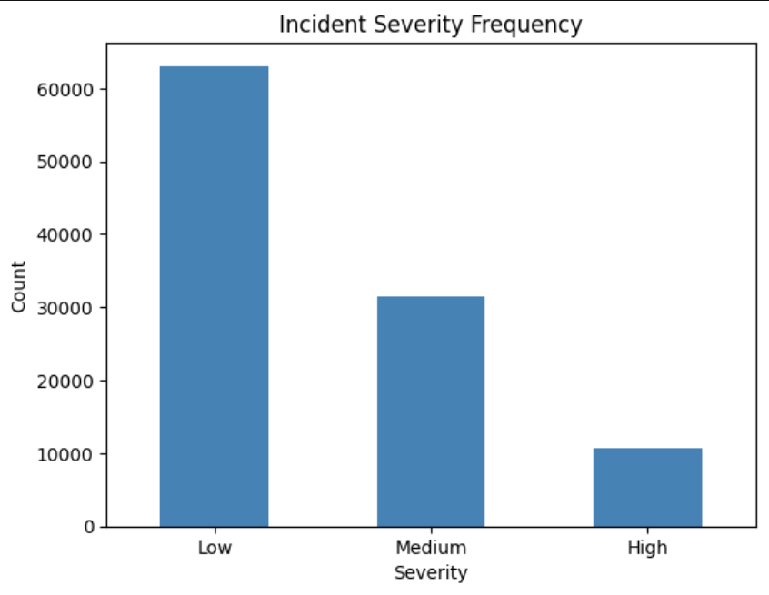
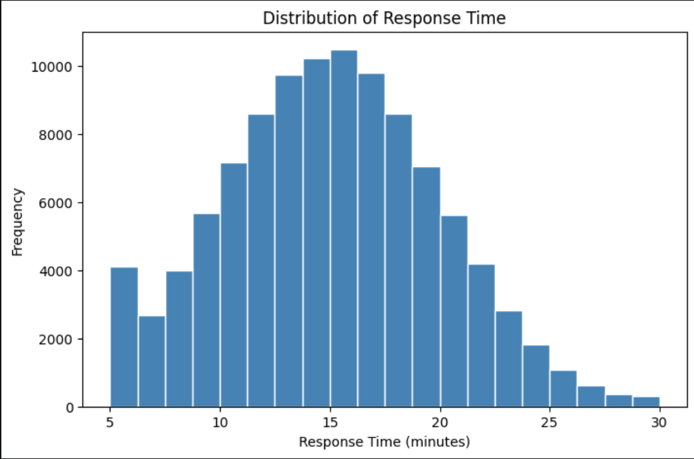
Frequency and central tendency
📊
📊
INSERT FIGURE HERE
INSERT FIGURE HERE
Bar Chart — Incident Severity Frequency
Histogram — Response Time Distribution
From: Activity_1_Descriptive_NEW.ipynb
From: Activity_1_Descriptive_NEW.ipynb
Code: df['Incident_Severity'].value_counts().plot(kind='bar')
Code: plt.hist(df['Response_Time'], bins=20)
Key results:
Severity: Low 59.99% (63K), Medium 30.01%, High 10.00% — most incidents routine
Region: Urban 70.1%, Suburban 20.0%, Rural 9.9% — operations urban-centred
Response_Time: Mean = 15.07 min ≈ Median = 15.03 min → symmetric distribution, mean is a reliable KPI
6/22

Slide 9
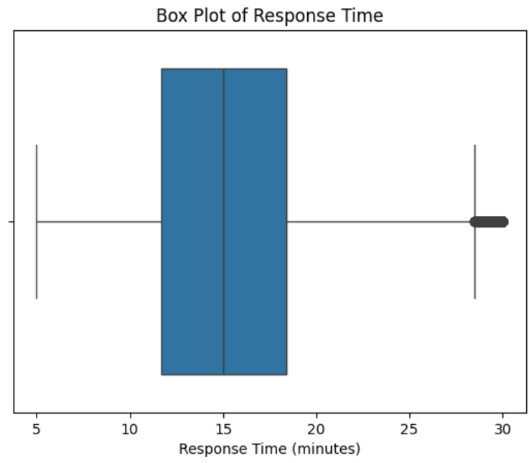
Dispersion and position
📊
Statistic | Response_Time | Distance
Std Dev | 4.88 min | 14.14 km
CV (%) | 32.42% | 55.54% (highest)
Q1 (25th %) | 11.68 min | 13.20 km
Q3 (75th %) | 18.40 min | 37.69 km
IQR | 6.72 min | 24.49 km
P90 (SLA) | 21.44 min | —
INSERT FIGURE HERE
Box Plot — Response Time (shows outliers, IQR, median)
From: Activity_1_Descriptive_NEW.ipynb
Code: sns.boxplot(x=df['Response_Time'])
Decision-making insights:
Distance has the highest CV (55.54%) — biggest source of unpredictable response times; pre-positioning ambulances reduces this variability
P90 = 21.44 min — 90% of incidents resolved within this time; set this as the data-driven SLA target
7/22

Slide 10
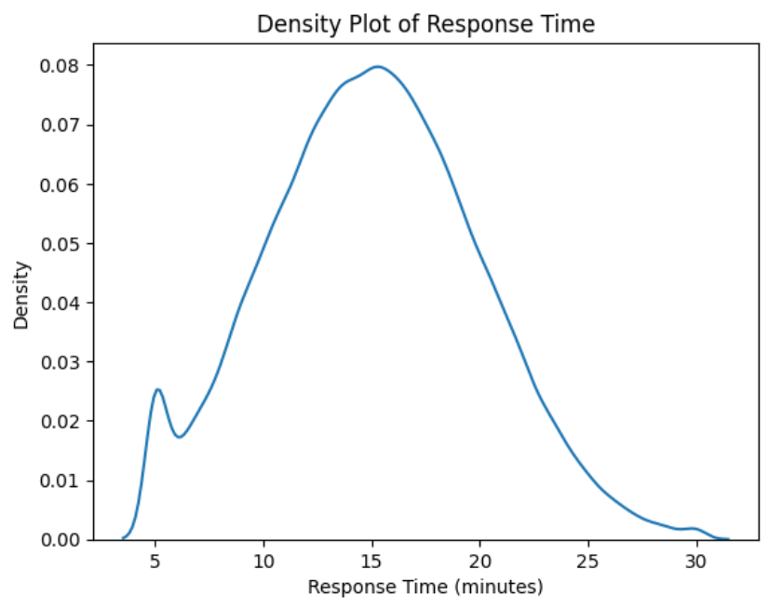
Outlier detection — Z-score and IQR methods
📊
📊
INSERT FIGURE HERE
INSERT FIGURE HERE
Box Plot — Response Time (visible outliers above 28.5 min)
Density Plot — Response Time KDE
From: Activity_1_Descriptive_NEW.ipynb
From: Activity_1_Descriptive_NEW.ipynb
Code: sns.boxplot(x=df['Response_Time']) — outlier section
Code: sns.kdeplot(df['Response_Time'])
Two outlier detection methods applied:
Z-Score method (|Z| > 3): detected 184 outliers — all at boundary values (~30 min)
IQR method (above Q3 + 1.5×IQR = 28.48 min): detected 381 outliers — more sensitive
Decision: extreme-delay incidents (>28.48 min) should trigger mandatory post-incident review
8/22

Slide 11
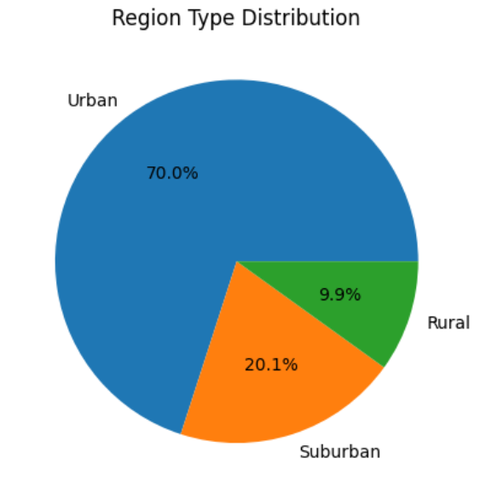
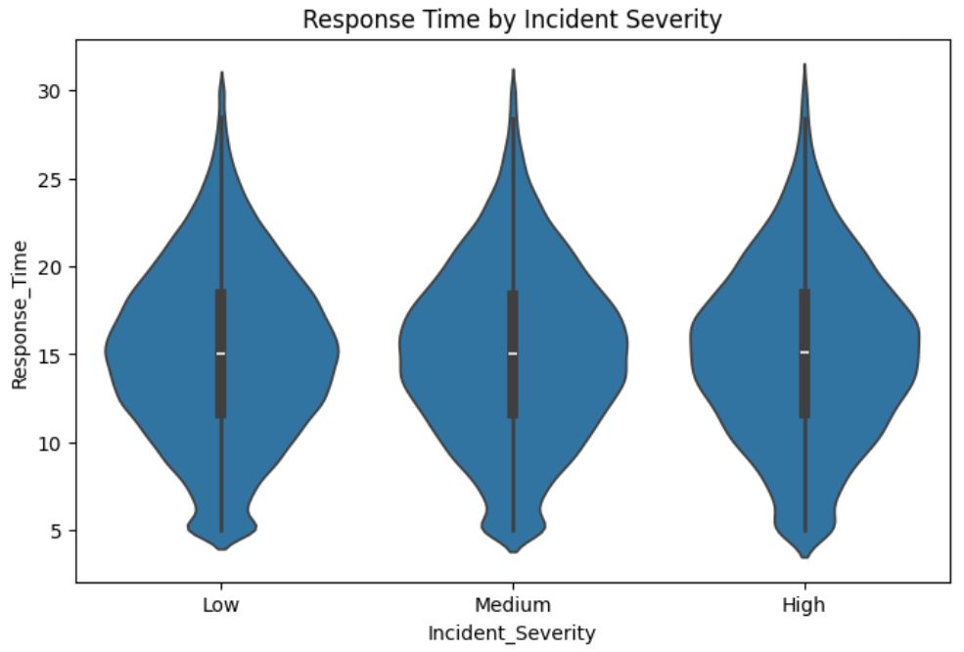
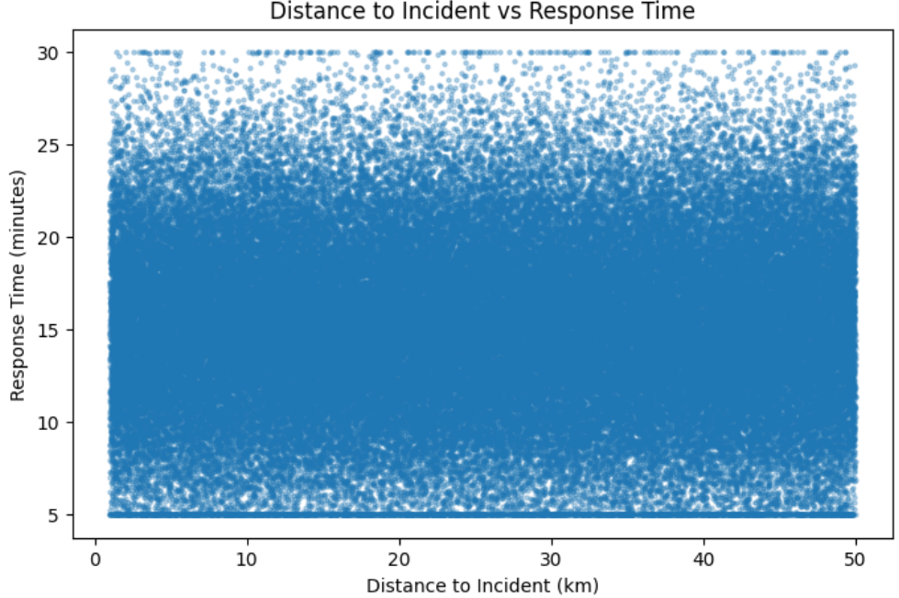
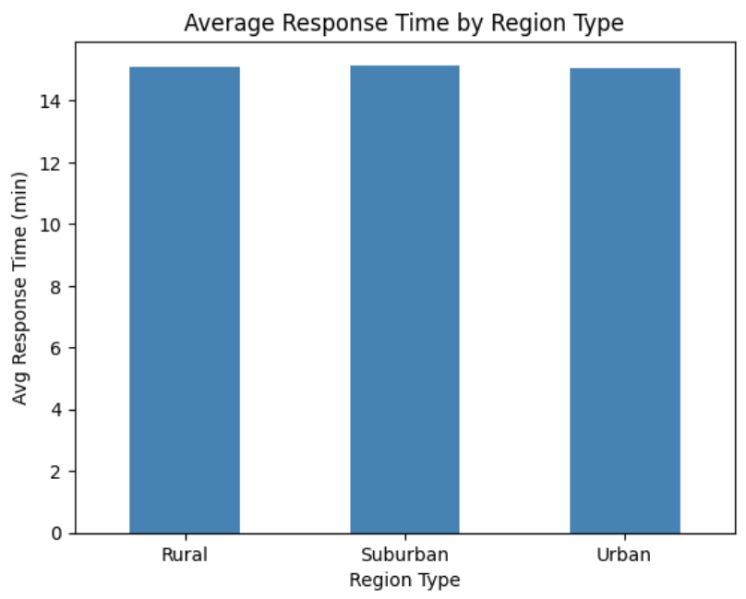
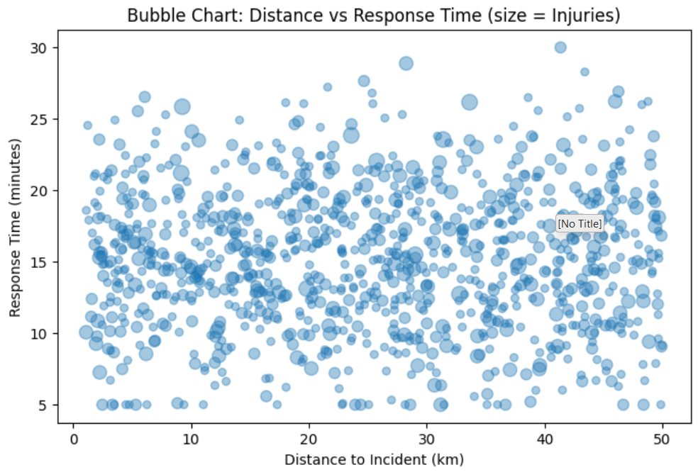
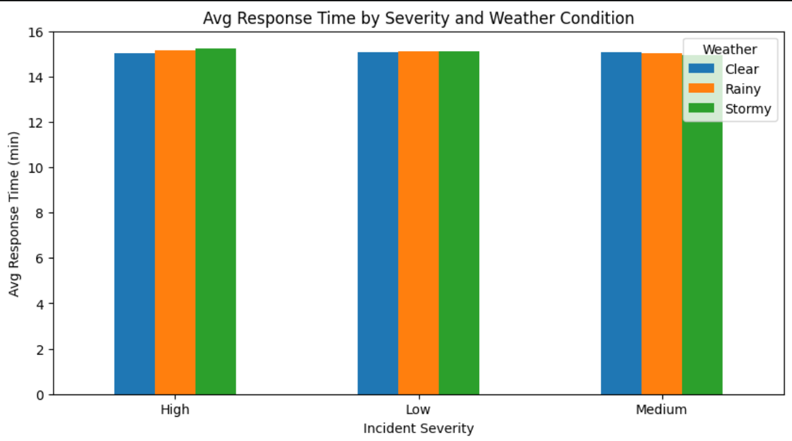
Visualizations — single and multi-column
📊
📊
📊
INSERT FIGURE HERE
INSERT FIGURE HERE
INSERT FIGURE HERE
Pie Chart — Region Type %
Violin Plot — RT by Severity
Scatter — Distance vs RT
From: Activity_1.ipynb
From: Activity_1.ipynb
From: Activity_1.ipynb
Code: df['Region_Type'].value_counts().plot(kind='pie')
Code: sns.violinplot(x='Incident_Severity', y='Response_Time')
Code: plt.scatter(df['Distance...'], df['Response_Time'])
📊
📊
📊
INSERT FIGURE HERE
INSERT FIGURE HERE
INSERT FIGURE HERE
Bar Chart — Avg RT by Region
Grouped Bar — Severity × Weather
Bubble — Distance vs RT (size=Injuries)
From: Activity_1.ipynb
From: Activity_1.ipynb
From: Activity_1.ipynb
Code: df.groupby('Region_Type')['Response_Time'].mean().plot(kind='bar')
Code: pivot_table().plot(kind='bar')
Code: plt.scatter(..., s=sample['Number_of_Injuries']*30)
9/22

Slide 12
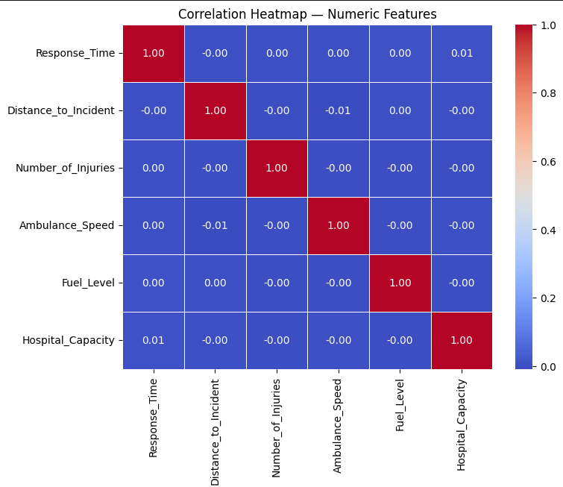
Correlation heatmap and contingency tables
📊
Contingency Tables computed:
Incident_Severity × Weather_Condition
Traffic_Congestion × Region_Type
INSERT FIGURE HERE
Feature | r with RT
Distance_to_Incident | −0.00
Number_of_Injuries | 0.00
Ambulance_Speed | 0.00
Fuel_Level | 0.00
Hospital_Capacity | 0.01
Correlation Heatmap — Numeric Features
From: Activity_1_Descriptive_NEW.ipynb
Code: sns.heatmap(corr, annot=True, cmap='coolwarm')
Critical finding:
All Pearson correlations with Response_Time are near zero (max |r| = 0.01). No single numeric feature linearly predicts RT.
This finding directly motivates the use of non-linear models in Activity 2 and constrained optimisation in Activity 3.
10/22

Slide 13
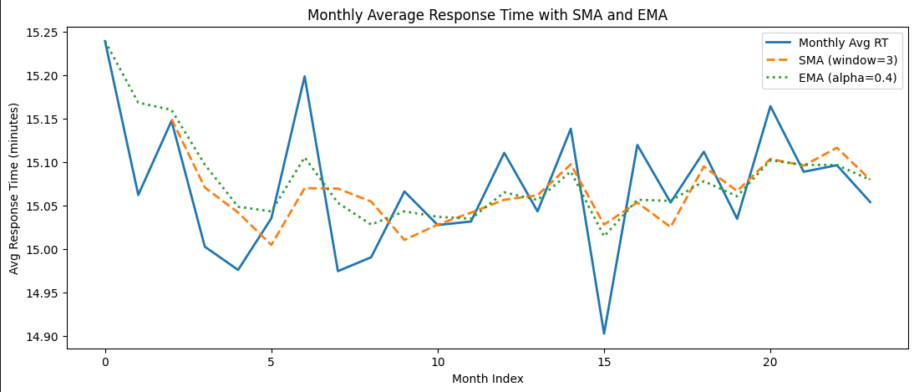
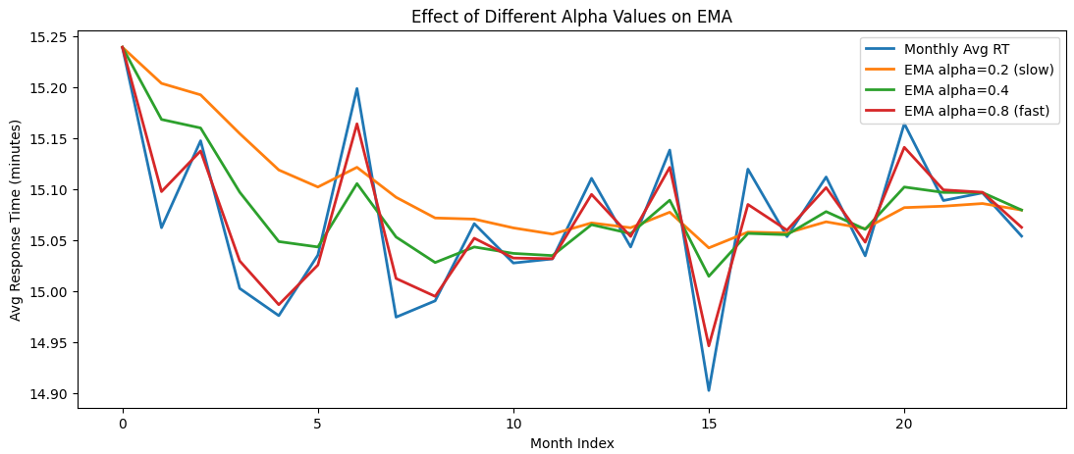
Time series analysis — SMA and EMA
Concepts:
SMA (Simple Moving Average, window=3): smooths short-term noise but lags 1-2 months behind recent changes
EMA (Exponential Moving Average, α=0.4): more weight to recent values, reacts faster to changes — better for real-time monitoring
Higher α (0.8) = highly reactive but noisy. Lower α (0.2) = very smooth but slow
Decision: Use EMA(α=0.4) for real-time dispatch dashboards
📊
INSERT FIGURE HERE
Monthly Avg RT with SMA(3) and EMA(α=0.4)
From: Activity_1_Descriptive_NEW.ipynb
Code: plt.plot(rt_series, sma_3, ema_4)
11/22

Slide 14
Activity 1 — how descriptive findings drive decisions (M2)
Technique | Key finding | Decision-making contribution
Frequency | 70.1% Urban, 60% Low severity | Concentrate resources in urban zones
Central tendency | Mean ≈ Median = 15.07 min | Reliable KPI; set 15-min performance target
Dispersion | Distance CV = 55.54% | Pre-position ambulances to reduce variability
Position | P90 = 21.44 min, IQR = 6.72 | Set SLA at 21 min (covers 90% of incidents)
Outliers | 381 incidents >28.48 min | Mandatory post-review for extreme delays
Correlation | All |r| ≈ 0 with RT | Linear models insufficient → motivates Activity 2
Contingency | Severity × Weather independent | Weather doesn't cause severity, only delays
Time Series | Stable trend, range 0.34 min | Use EMA(α=0.4) for real-time monitoring
12/22

Slide 15
Activity 2 — Predictive Analytics
Forecasting Response_Time with 4 machine learning models
13/22

Slide 16
Feature selection — SelectKBest and RFE
SelectKBest (Filter Method):
Scores each feature independently using F-regression (linear relationship strength). Selects top K=10.
RFE (Wrapper Method):
Trains Linear Regression, removes weakest feature iteratively until K=10 remain. Considers feature interactions.
Selected by BOTH methods (10 features)
Incident_Type · Region_Type · Traffic_Congestion · Hospital_Capacity · Distance_to_Incident · Emergency_Level · Fuel_Level · Dispatch_Coordinator · Year · Month
Critical finding:
Both methods agreed on the EXACT same 10 features — perfect agreement.
This consistency confirms the stability of the selected feature set as the most relevant predictors for the modelling stage.
14/22

Slide 17
Models 1–2: Linear Regression and KNN
Linear Regression — Baseline
KNN (K=5)
Concept:
Finds best linear formula: RT = β₀ + β₁·F1 + ... + β₂₀·F20
Uses Ordinary Least Squares (OLS) to minimise sum of squared errors
Results:
MAE = 3.94 min · RMSE = 4.89 min
R² = −0.0005 (≈ predicts the mean)
Best overall model — most stable
Concept:
For each test incident, finds 5 most similar training incidents (Euclidean distance) and averages their RT values.
Results:
MAE = 4.30 min · RMSE = 5.35 min
R² = −0.20
Limitation:
Curse of dimensionality — with 20 features, neighbours are not truly similar.
15/22

Slide 18
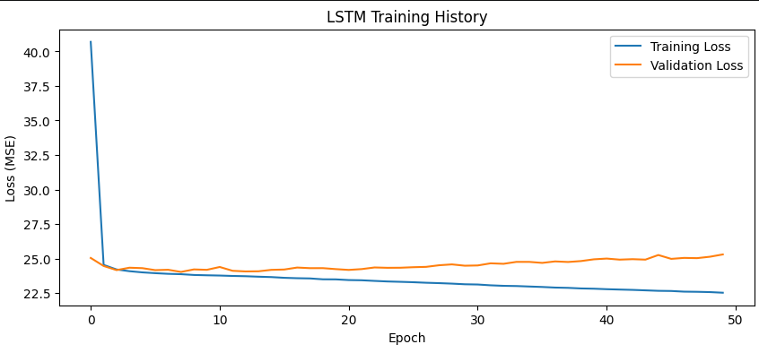
Models 3–4: Decision Tree and LSTM
Decision Tree
LSTM (Deep Learning)
Concept:
Learns if/else threshold rules to split data into leaf nodes (predictions).
Results:
MAE = 5.71 min · RMSE = 7.11 min
R² = −1.12
Severe overfitting:
Unlimited depth memorises noise; R²<0 means worse than predicting mean.
📊
INSERT FIGURE HERE
LSTM Training History (Loss curves)
From: Activity_2_Predictive_NEW.ipynb
Code: plt.plot(history.history['loss'])
Architecture: LSTM(64) → Dense(32) → Dense(1)
23,873 trainable parameters, 50 epochs
Results: MAE=4.05, RMSE=5.03, R²=−0.06
Mild overfitting after epoch ~10
16/22

Slide 19
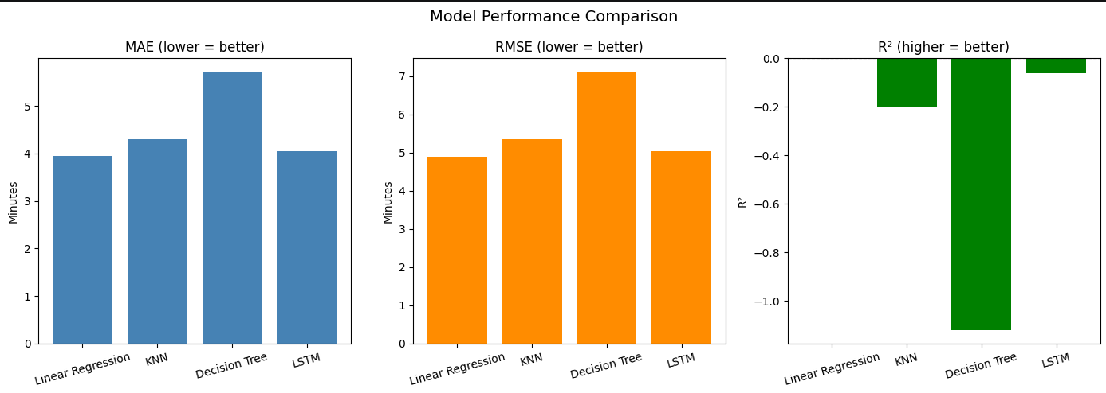
Model performance comparison (M3)
📊
INSERT FIGURE HERE
Model Comparison Bar Charts — MAE, RMSE, R² (3 panels)
From: Activity_2_Predictive_NEW.ipynb
Code: fig, axes = plt.subplots(1, 3, ...) — Model Performance Comparison
Model | MAE | RMSE | R² | Rank
Linear Regression | 3.94 | 4.89 | −0.0005 | 1 — Best
LSTM | 4.05 | 5.03 | −0.06 | 2
KNN | 4.30 | 5.35 | −0.20 | 3
Decision Tree | 5.71 | 7.11 | −1.12 | 4 — Worst
Best model: Linear Regression — simplest model wins because the dataset has no strong feature-target signal; complex models overfit noise.
17/22

Slide 20
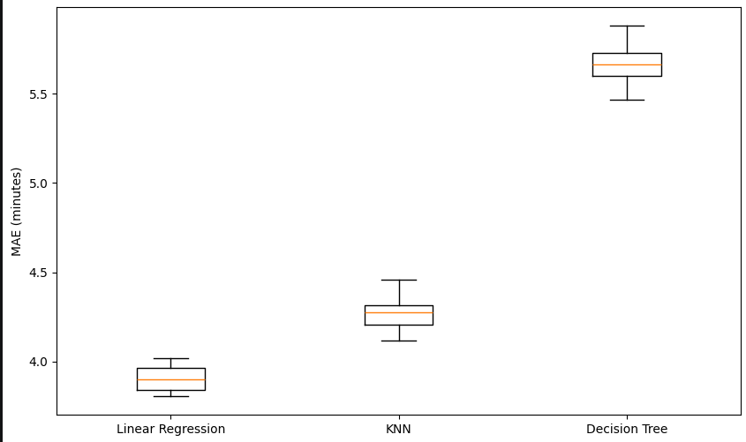
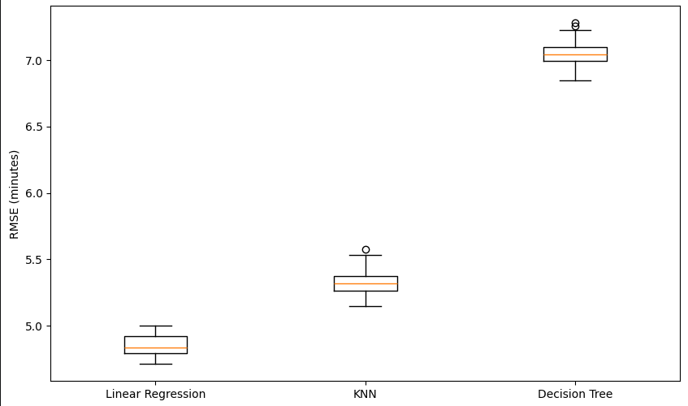
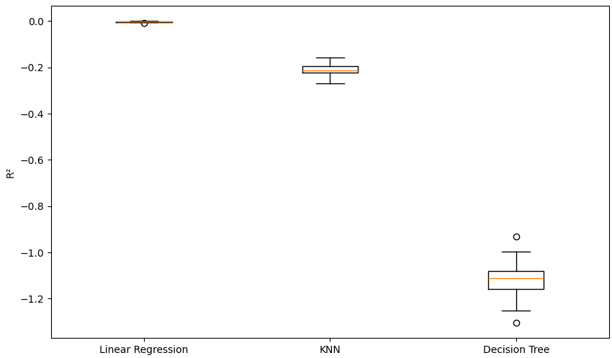
Multiple runs comparison — 30 random train/test splits (M3)
📊
📊
📊
INSERT FIGURE HERE
INSERT FIGURE HERE
INSERT FIGURE HERE
Boxplot — MAE across 30 runs
Boxplot — RMSE across 30 runs
Boxplot — R² across 30 runs
From: Activity_2_Predictive_NEW.ipynb
From: Activity_2_Predictive_NEW.ipynb
From: Activity_2_Predictive_NEW.ipynb
Code: ax.boxplot([results_multi[m]['MAE'] ...])
Code: ax.boxplot([results_multi[m]['RMSE'] ...])
Code: ax.boxplot([results_multi[m]['R2'] ...])
What boxplots reveal:
Linear Regression — tightest box (most consistent across runs); average MAE = 3.90, range 3.78–4.05
KNN — moderate spread; average MAE = 4.27, range 4.10–4.45
Decision Tree — widest box with outliers (most unstable); confirms overfitting
Linear Regression is not only best but also most stable — the recommended model for forecasting (D2)
18/22

Slide 21
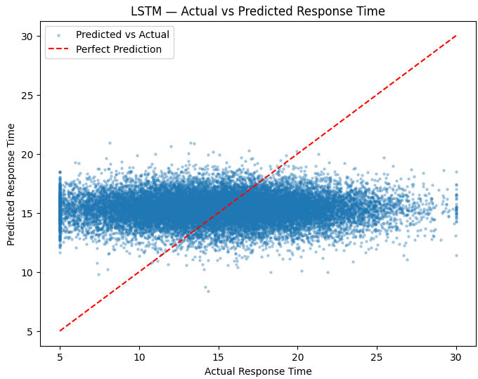
Critical evaluation — predictive analytics for forecasting (D2)
What predictive analytics revealed:
All 4 models converge to R² ≈ 0 → no individual feature predicts RT
Simplest model (Linear Regression) outperforms complex ones (LSTM)
LSTM trained successfully (loss 40→22.5) but cannot extract signal
Decision Tree without depth limit: R²=−1.12 (severe overfitting)
Forecasting verdict:
Standard regression cannot reliably forecast individual incidents from this dataset → motivates Activity 3's constrained optimisation approach
📊
INSERT FIGURE HERE
LSTM Actual vs Predicted Scatter
From: Activity_2_Predictive_NEW.ipynb
Code: plt.scatter(y_test, y_pred_lstm)
19/22

Slide 22
Activity 3 — Prescriptive Analytics
Genetic Algorithm with pygad library
20/22

Slide 23
Genetic Algorithm — concept and optimal solution
How the GA works (pygad library):
Each chromosome = [w1, w2, w3, w4, b] (5 weights)
Population: 50 chromosomes evolving over 300 generations
Selection: tournament — fittest of random group becomes parent
Crossover: uniform — genes from either parent (50/50)
Mutation: random (20% genes); Elitism: top 5 preserved
Fitness = −RMSE (maximise = minimise prediction error)
Constraint bounds:
w1 ∈ [0.2, 0.8] — Distance
w2 ∈ [0.1, 0.5] — Injuries
w3 ∈ [0.0, 0.03] — Hosp. Capacity
w4 ∈ [0.0, 0.04] — Fuel Level
b ∈ [5.0, 10.0] — Baseline
Optimal formula found by GA (M4):
RT = 0.2011×Distance + 0.1004×Injuries + 0.0017×HospCap + 0.0041×Fuel + 9.4002
Avg Predicted RT: 15.0541 min | Avg Actual RT: 15.0701 min | Difference: −0.016 min (essentially zero — unbiased)
21/22

Slide 24
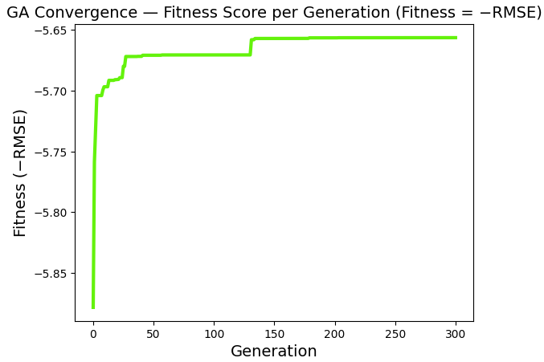
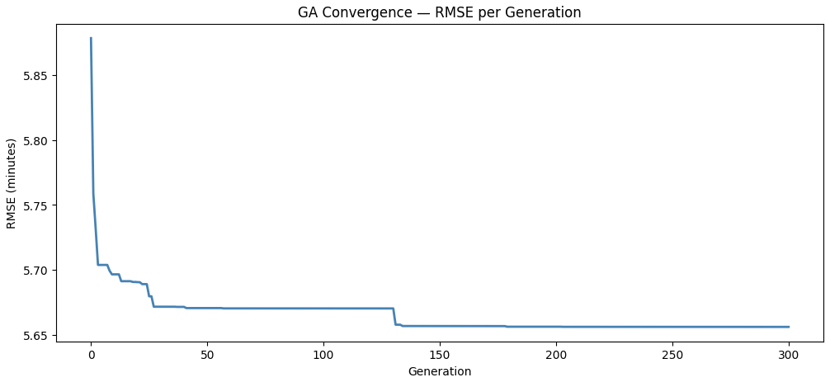
GA convergence and dispatch application (D3)
📊
INSERT FIGURE HERE
Fitness Convergence (pygad plot_fitness)
From: Activity_3_Prescriptive_NEW.ipynb
Code: ga_instance.plot_fitness()
Convergence analysis:
Initial RMSE (gen 1) = 5.8782 min → Final RMSE (gen 300) = 5.6563 min
Stepped convergence: rapid drop in first 30 gens, second improvement at gen ~130, then stable plateau
Flat plateau after gen ~150 confirms the GA found the global optimum
Application: Dispatchers can rank ambulance units by predicted RT in real-time using the simple formula
22/22

